Slide 1
Customer segmentation
BATCH NO:18
2003A51009 Medaraboina Soumya
2003A51026 Mohammad Tajuddin
2003A51028 Rayikanti Srija
2003A51070 Ajmeera savya

Slide 2
OBSERVATION
These days, we can easily personalize details of the objectives in an order.
Customer segmentation means grouping your customers according to various characteristics.
For example segmenting customer details grouping by their age,their ids etc..
One of the fundamental steps towards better personalization is customer segmentation.

Slide 3
PURPOSE:
Knowing the differences between customer groups.
It’s easier to make strategic decisions regarding product growth and marketing.
This is a way for organizations to understand their customers.

Slide 4
DATASET:
The customer dataset consists of some features .they are:
Customer _id: Id of a customer for a particular business.
Customer _age: age of a customer for a particular business.
Gender: gender of the customer whether female or male.
Annual income:the Annual income of the customer.
Spending score: the score of the customers hoe much they are showing and how much in repect To their interest..

Slide 5
Types Of Segmentation Factors
DEMOGRAPHIC
*Age
*Gender
*Income
*Location
*Education
*Ethincity
PSYCHOGRAPHIC
*Interests
*Lifestyles
*Pyshchological Influences
*Motivations
*Priorities

Slide 6
Types Of Segmentation Factors
BEHAVIOURAL
*Purchasing Habits
*Spending Habits
*User Status
*Brand Interactions
Geographic
*Zip Code
*City
*Country
*Climate
*Urban or Rural

Slide 7
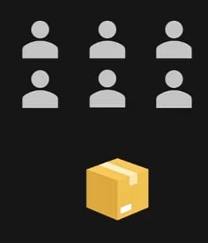
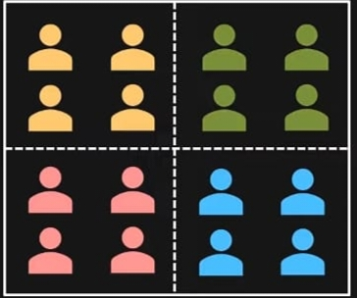
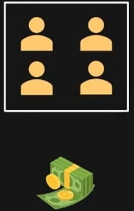
WHAT IS CUSTOMER SEGMENTATION?
Determine customers to sell products
Applying Cluster Algorithm
Sell Product to Targeted customers

Slide 8
ADVANTAGES OF CUSTOMRER SEGMENTATION
Price Optimization
Enhances Competitiveness
Brand Awareness
Acquisition and Retention
Increases Revenue and RDi

Slide 9
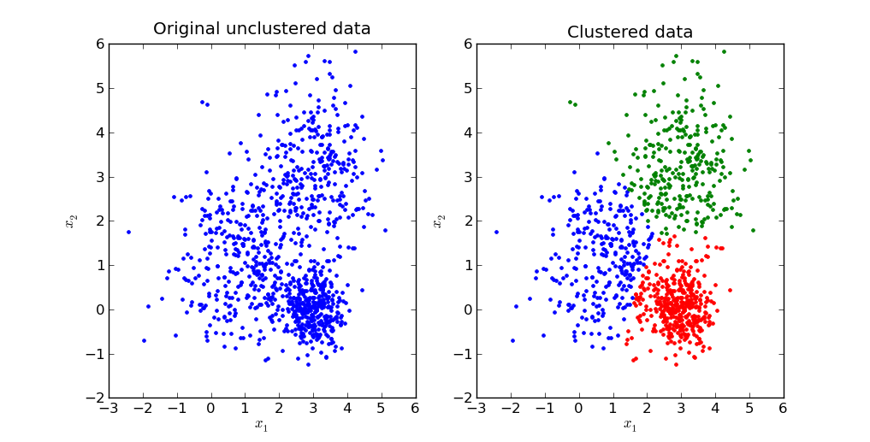
K-Means Algorithm
It is an interactive algorithm that divides the unlabelled dataset into K different clusters in such a way that each dataset belongs only one group that has similar products
This Photo by Unknown Author is licensed under CC BY-SA

Slide 10

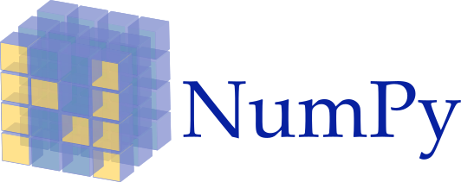

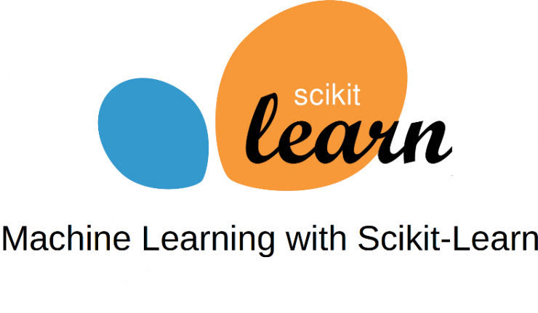

Environments and Tools for the Project
Language : Python
Pandas

Slide 11
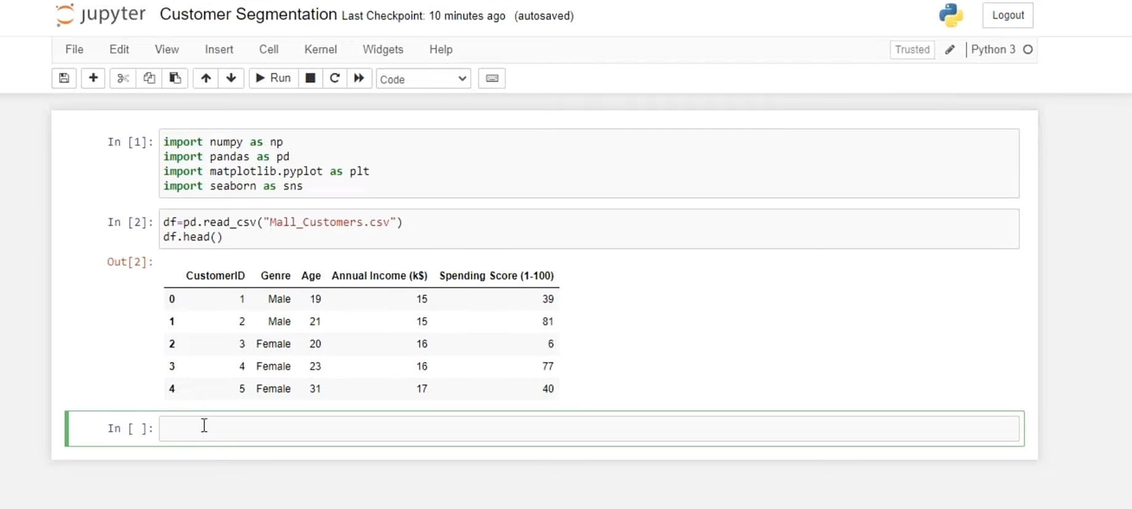

Slide 12
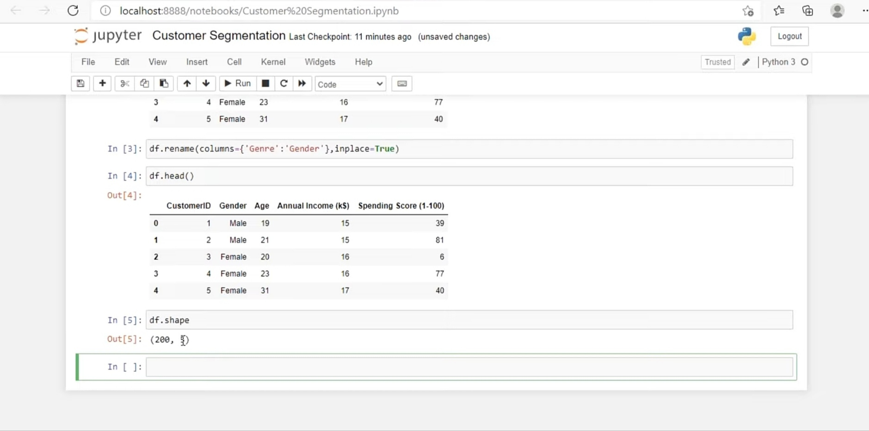

Slide 13
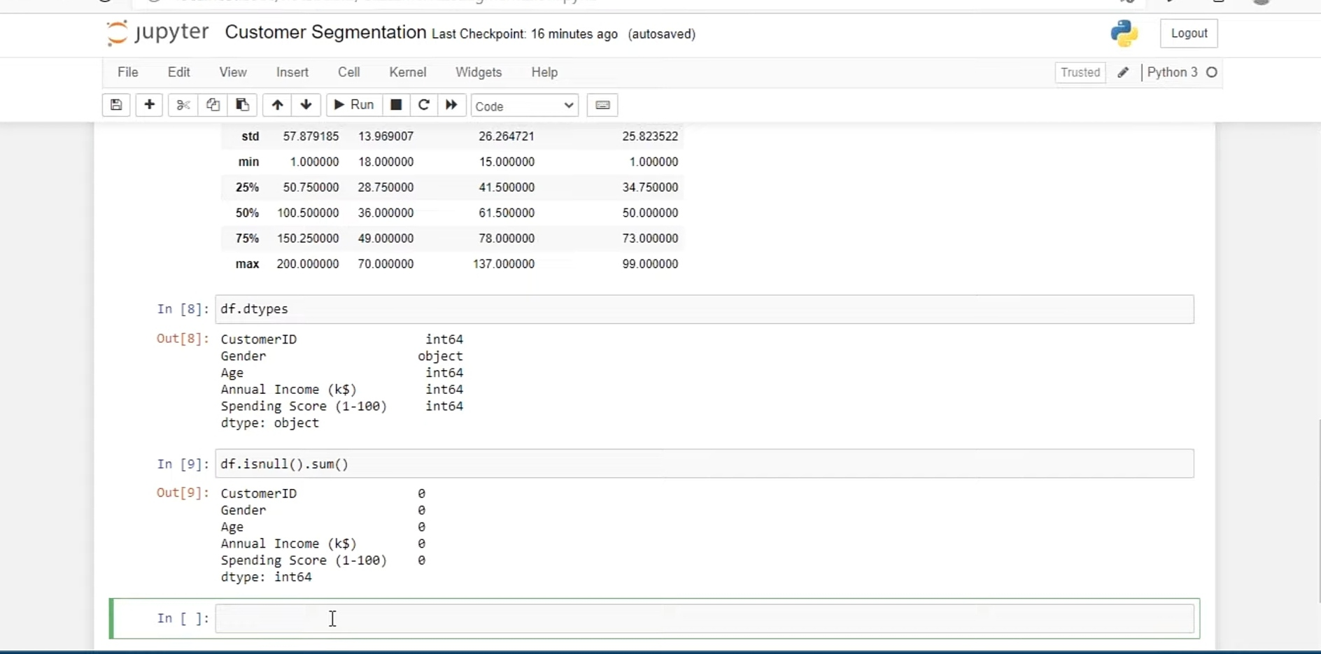

Slide 14
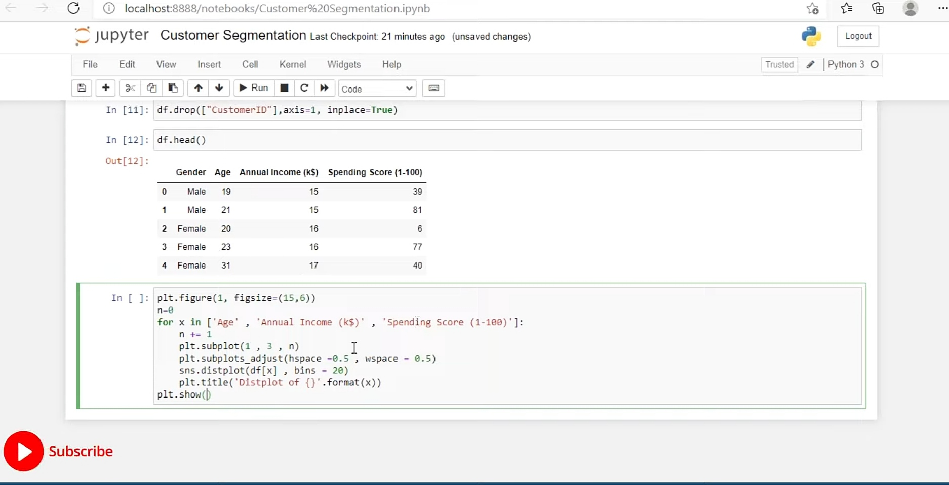

Slide 15
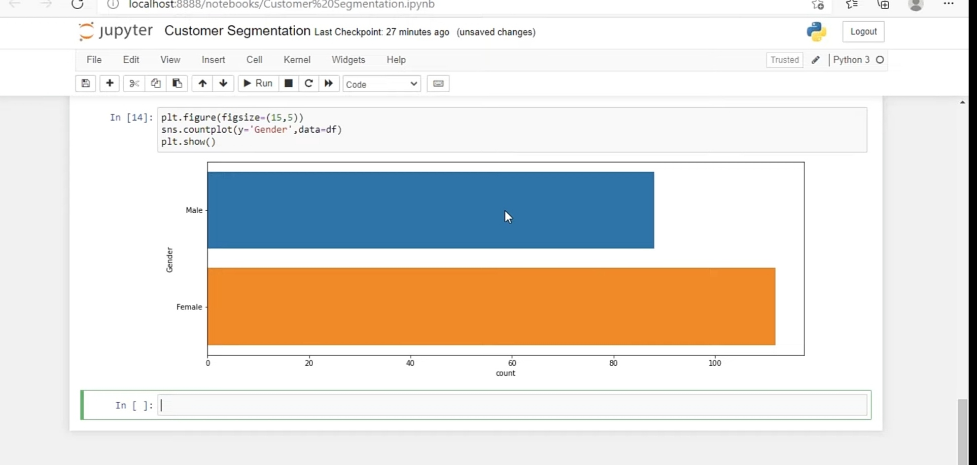

Slide 16
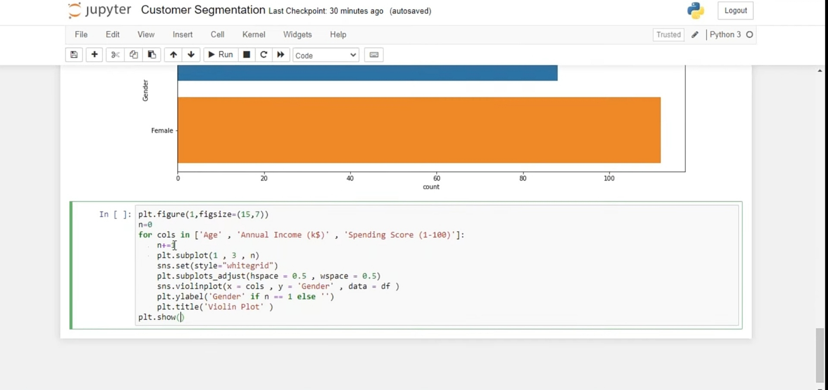

Slide 17
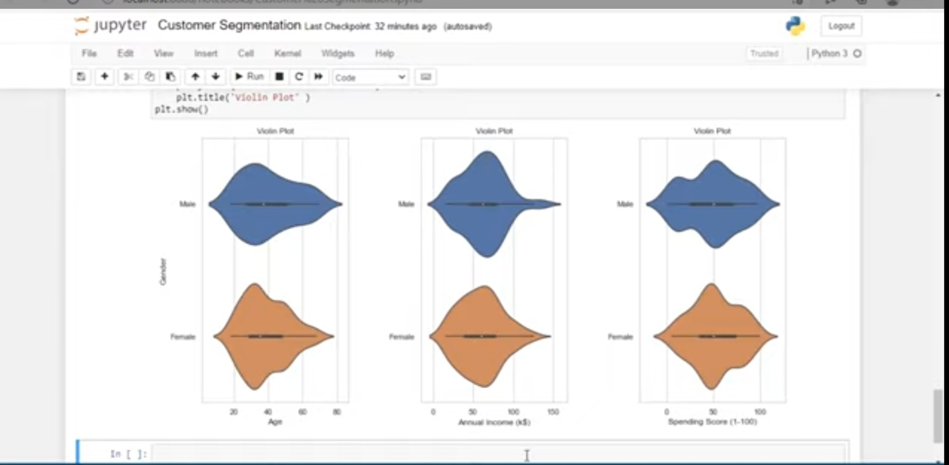

Slide 18
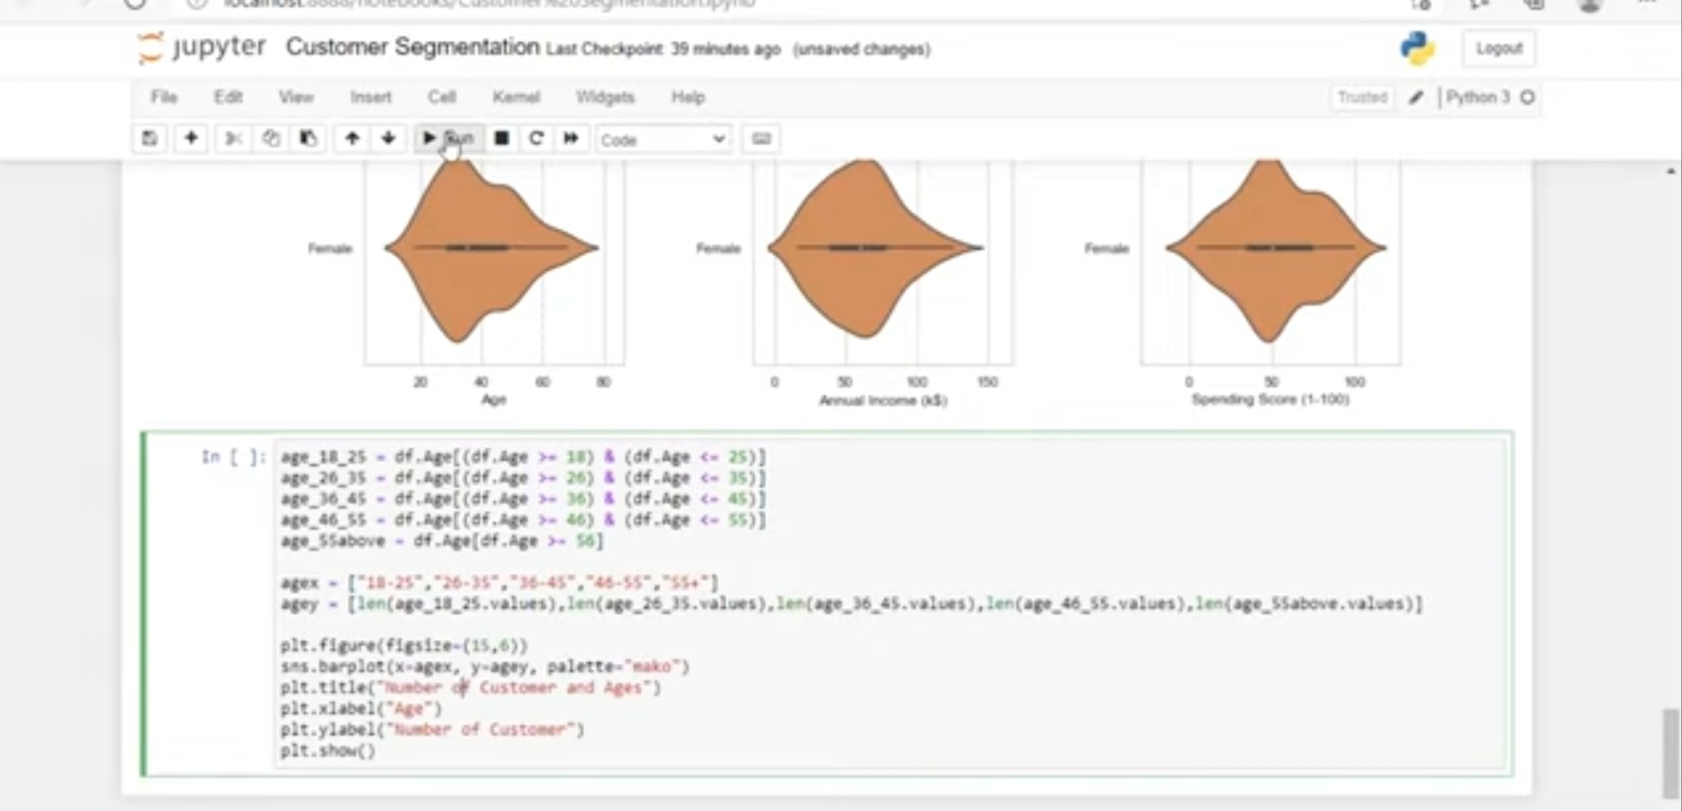

Slide 19
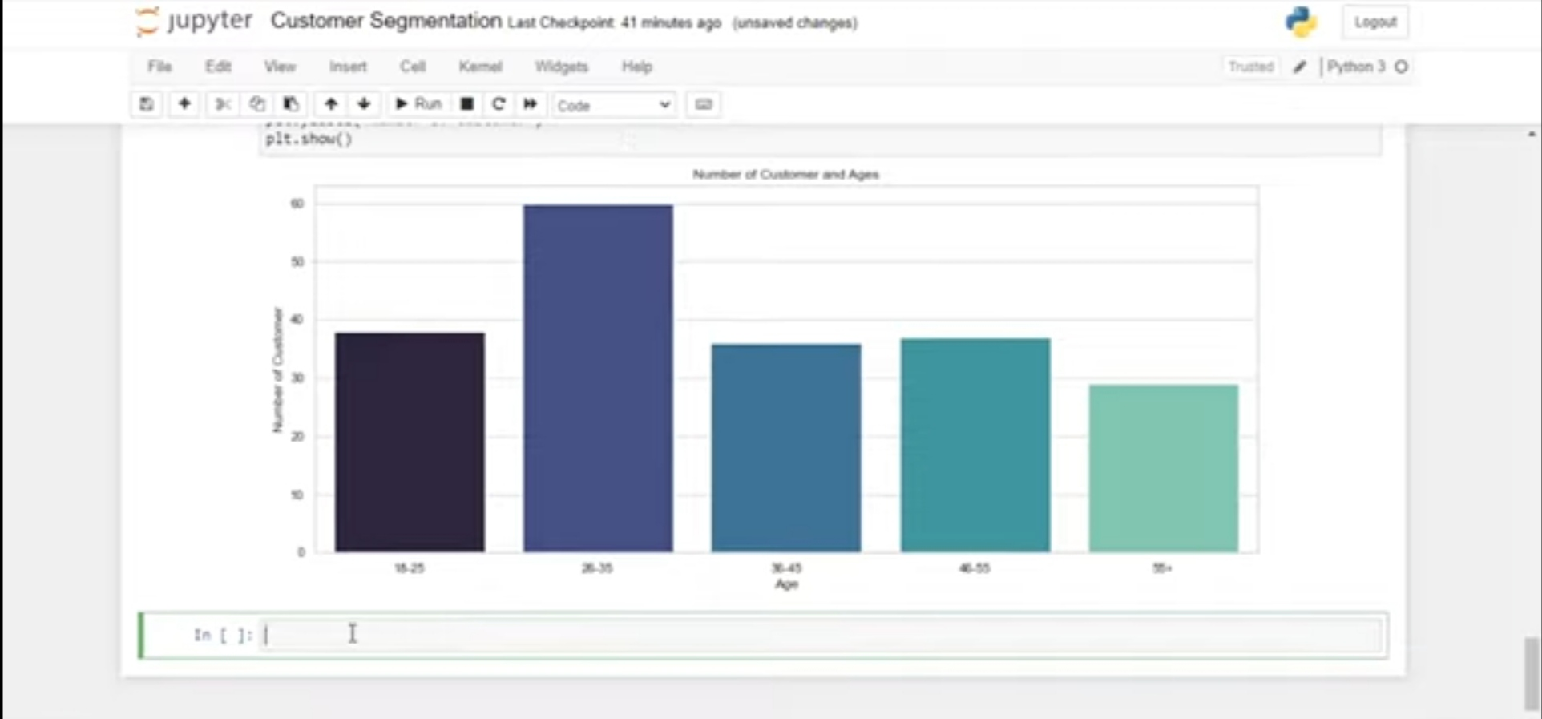

Slide 20
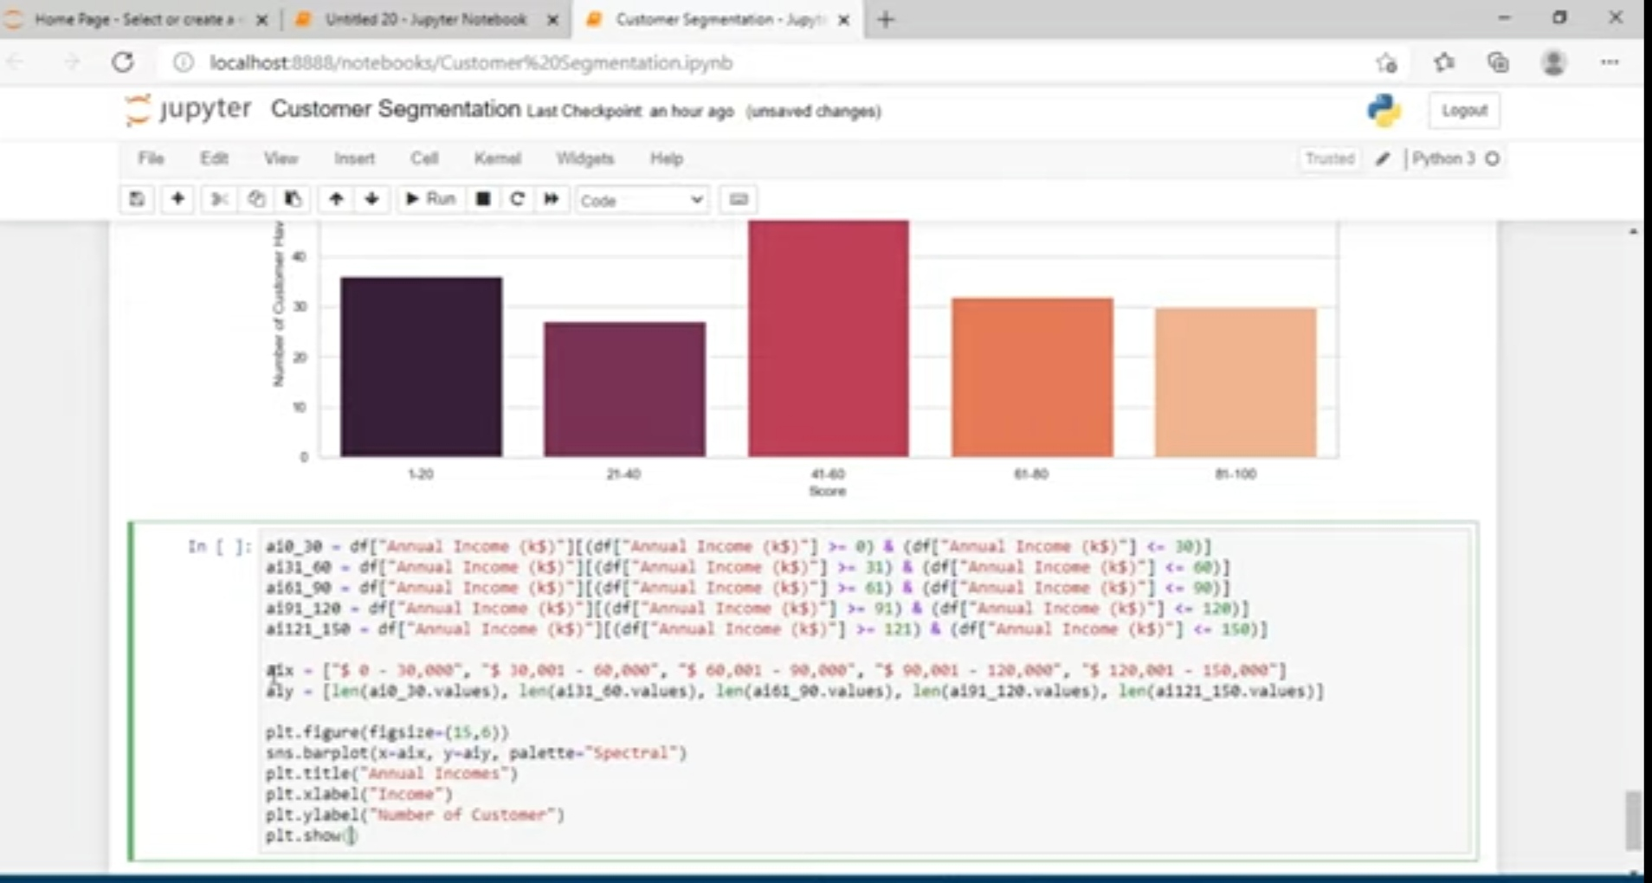

Slide 21
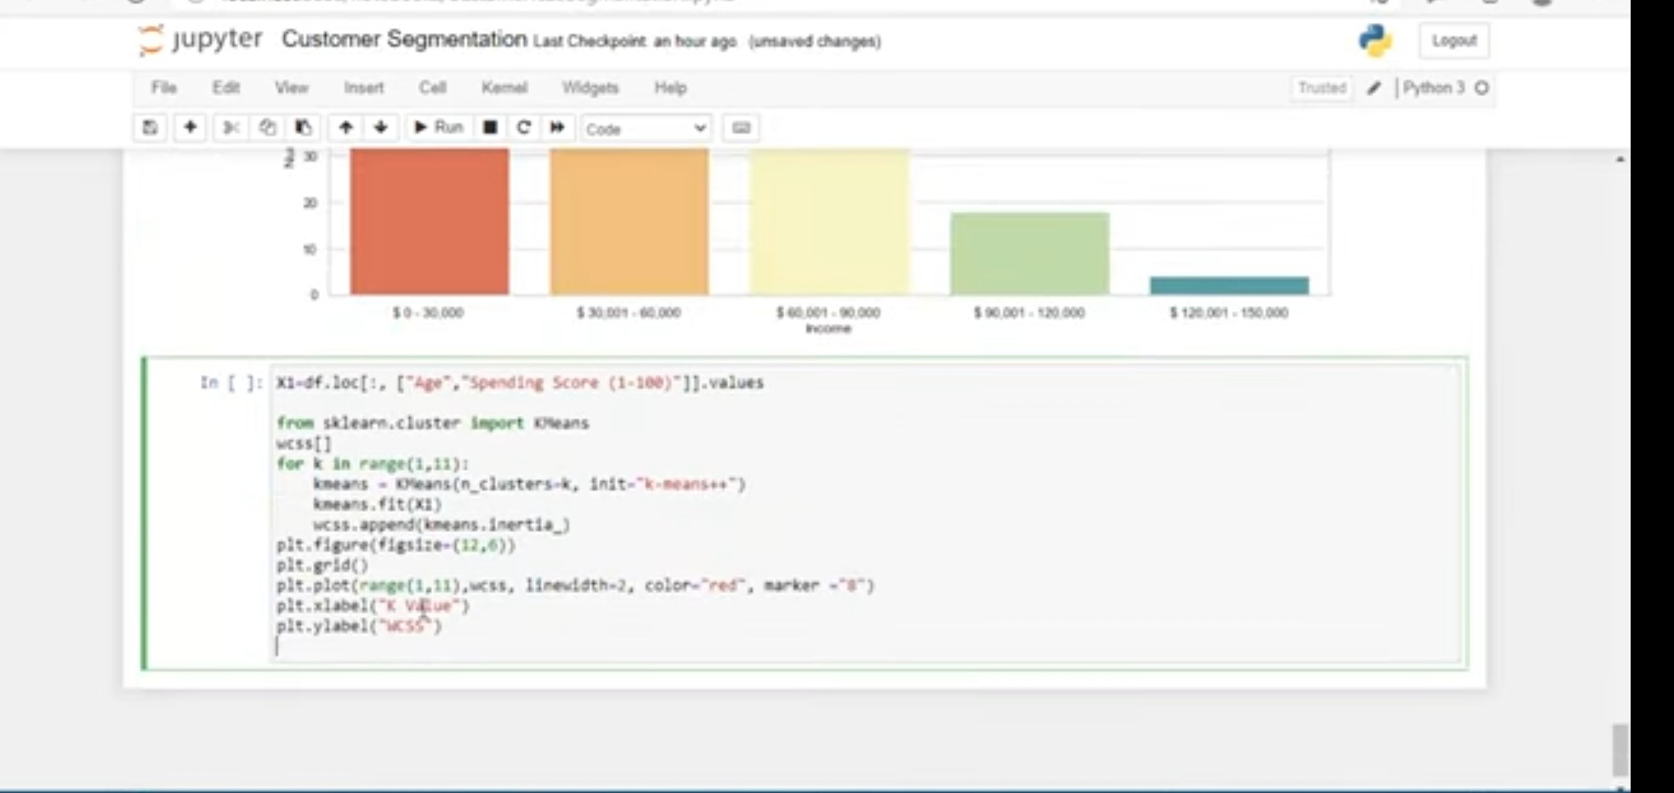

Slide 22
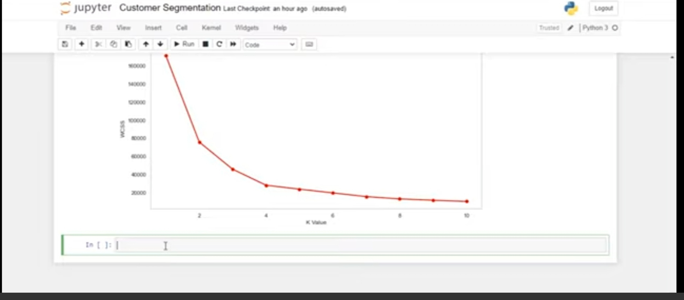

Slide 23
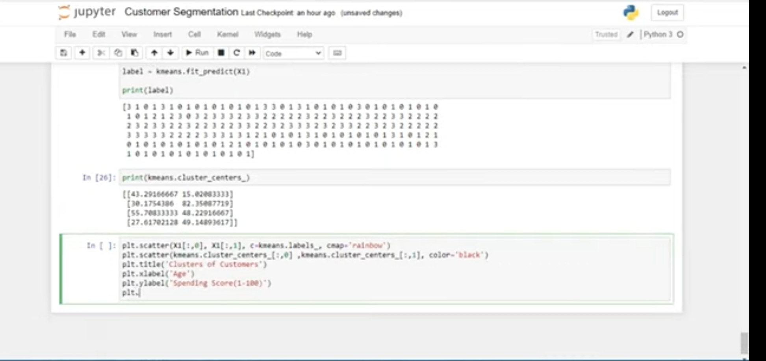

Slide 24
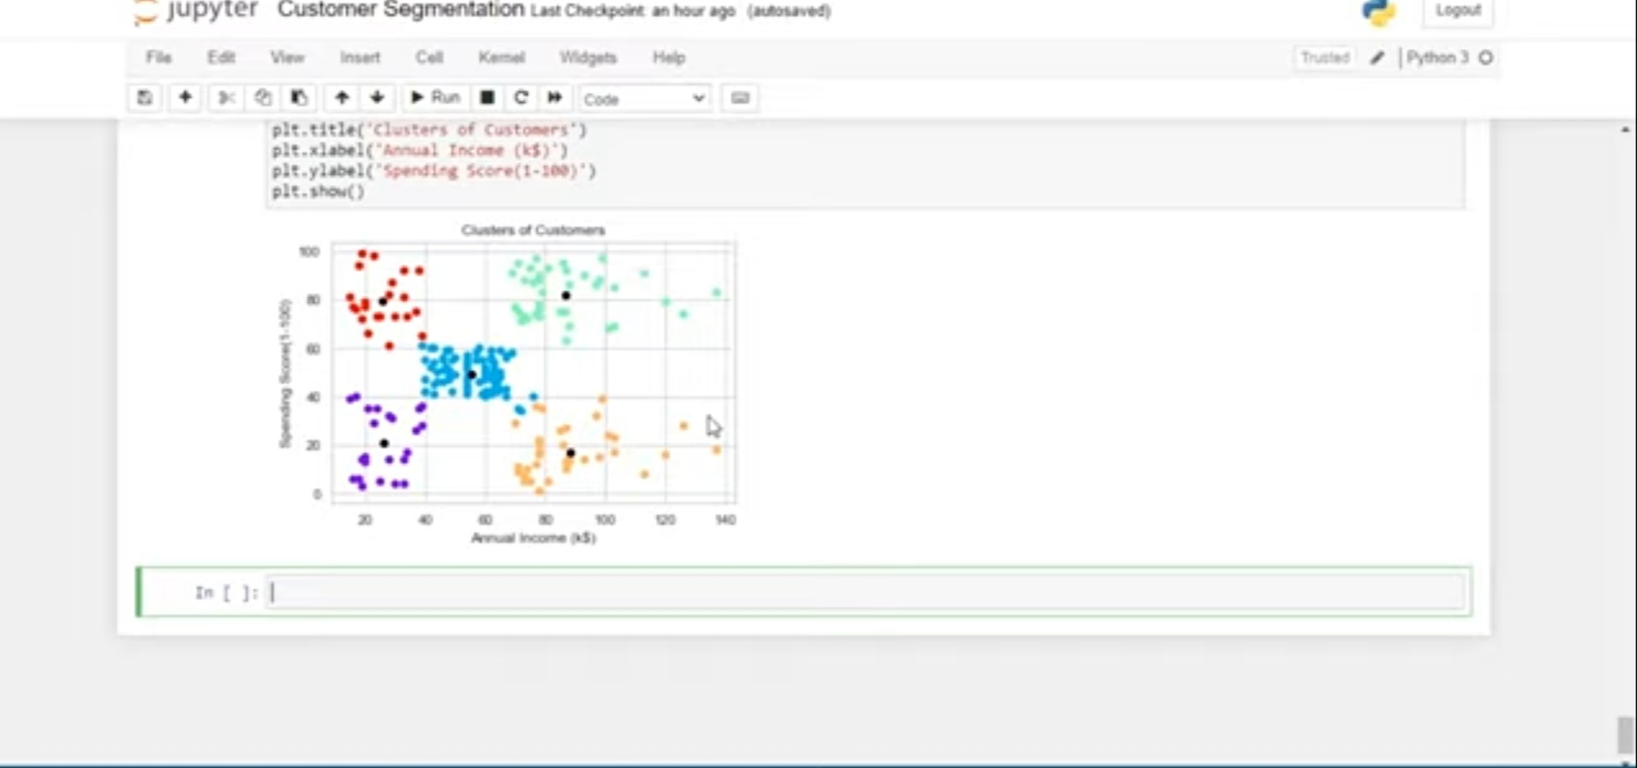

Slide 25
THANK YOU

